Slide 1


Sustainable Agriculture With AI for Crop Yield Products
TY CSE AIML
Student Names : Yuvraj Narwade B-61 Yash Gade B-57 Sumeet Made B-47 Gangadhar Gore B-07

Slide 2
Learning Objectives
Understand the integration of AI with IoT sensors, satellite imagery, and drones for real-time farm monitoring.
Learn how machine learning models predict crop yields based on environmental and historical data.
Analyze the impact of AI-driven precision farming on sustainability and resource optimization.
Explore techniques for reducing water, fertilizer, and pesticide use via AI recommendations.
Gain insights into developing user-centric AI products tailored for farmers and agronomists.
Source :
www.freepik.com/

Slide 3
Tools and Technology used
IoT sensors: Soil moisture, temperature, nutrient sensors deployed in the field.
Satellite and drone imagery platforms: Google Earth Engine, DJI drones for NDVI and crop health monitoring.
Machine Learning frameworks: TensorFlow, PyTorch for building predictive models.
Cloud Platforms: AWS IoT, Azure FarmBeats for data collection, storage, and processing.
Visualization & UI: Power BI, Dash, or React-based dashboards for farmer-friendly insights.

Slide 4
Methodology
Data Collection: Gather multi-source data (sensor readings, weather, satellite images).
Data Preprocessing: Clean, normalize, and engineer features relevant to crop yield.
Model Training: Use supervised learning algorithms (Random Forest, CNNs for image data).
Validation: Test model accuracy using historical yield data and real-time validation.
Deployment: Integrate model into an application for real-time predictions and recommendations.

Slide 5
Problem Statement:
Traditional farming lacks precise data on soil and crop health leading to inefficiencies.
Overuse of water, fertilizers, and pesticides harms the environment and raises costs.
Farmers lack accessible, actionable insights tailored to local conditions.
Crop yield variability due to weather and disease is hard to predict without AI.
There is a need for sustainable methods to increase productivity while minimizing environmental impact.

Slide 6
Solution:
Develop an AI-powered platform integrating sensor data, satellite imagery, and weather forecasts.
Use predictive models to forecast yields and suggest optimized irrigation and fertilization schedules.
Provide early warning alerts for pests and diseases via drone image analysis.
Design an easy-to-use mobile app/dashboard for farmers with visual insights and recommendations.
Continuously improve models with feedback and new data for adaptive farming support.

Slide 7
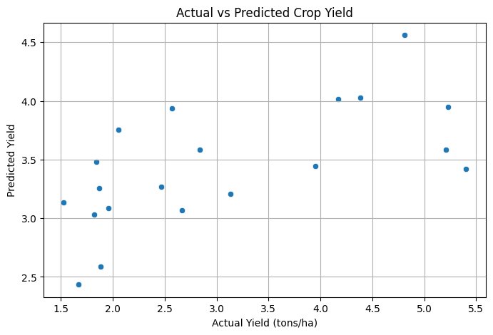
Screenshot of Output:

Slide 8
Conclusion:
AI integration in sustainable agriculture significantly improves crop yield predictions.
Precision farming reduces water, fertilizer, and pesticide usage, benefiting the environment.
Data-driven decisions empower farmers, reducing costs and increasing productivity.
Continuous data collection and AI model updates enable adaptability to changing conditions.
Sustainable agriculture AI products are vital for future food security and environmental health.
https://github.com/Garuda1802/sustainable-ai-agriculture

